Slide 1




Reconstruction following a disaster

Slide 2
Reconstruction following a disaster
What is Habitat for Humanity?
2. HFH History in disaster reconstruction
3. A picture of disaster trends
4. HFH strategy – “Pathways to Permanence”
5. HFH Japan Response

Slide 3
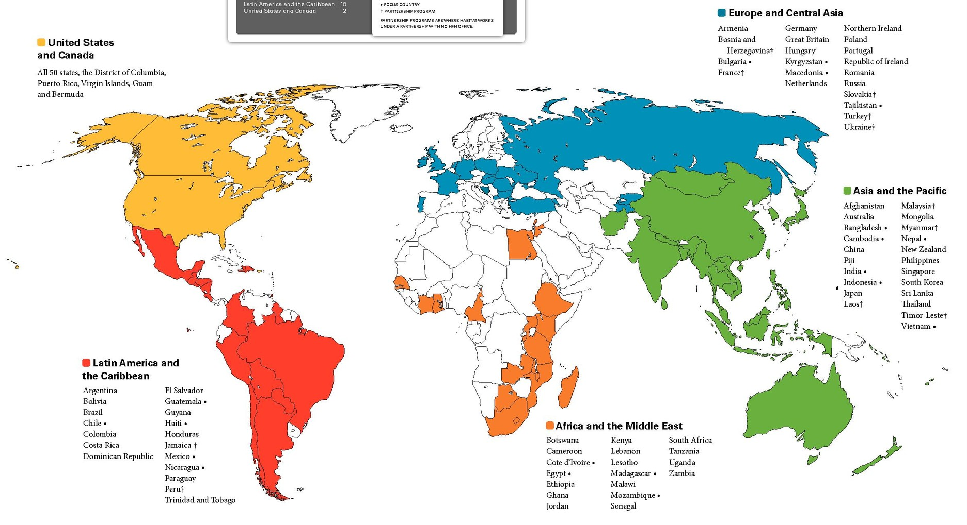

Slide 4
Total homes built and repaired FY 11/12
(including disaster response):

Slide 5
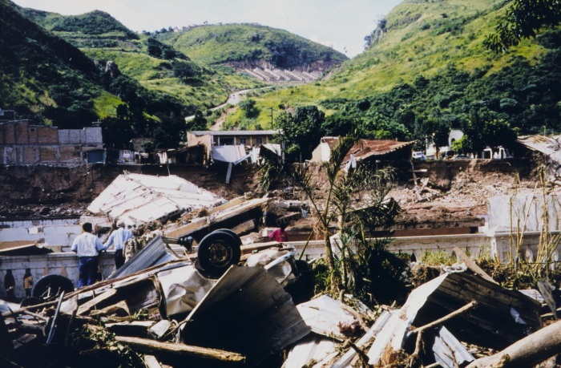
Hurricane Mitch, 1998
Central America
Over $6 billion worth of damage caused
Nearly 5,000 houses built and repaired in Guatemala, El Salvador, Honduras, Nicaragua and the Dominican Republic

Slide 6
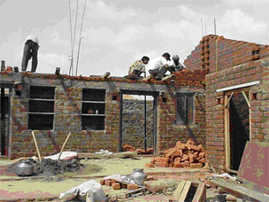
Gujarat Earthquake, 2001
India
20,000 deaths and 167,000 injured
541 homes built and repaired in Gujarat
664 houses built and repaired in Sikhra and Khumbariya.

Slide 7
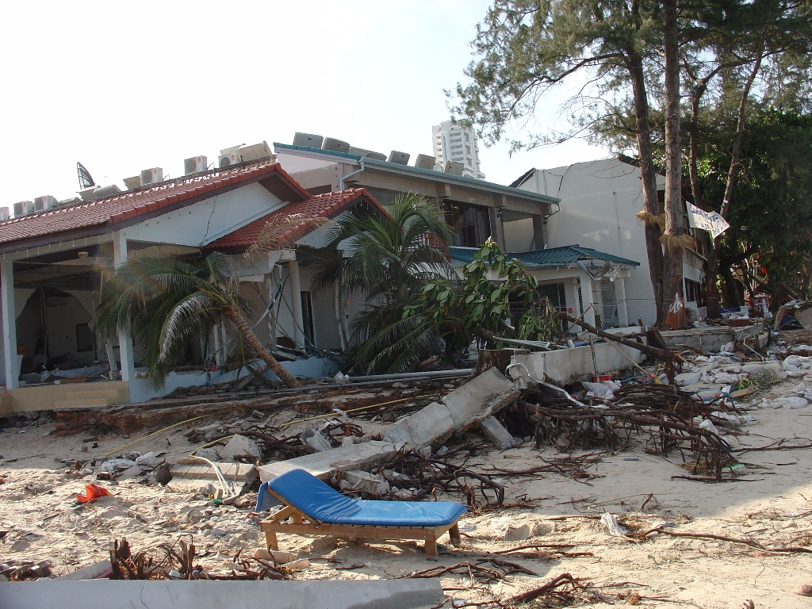
Indian Ocean Tsunami, 2004
More than 225,000 deaths and disappearances
141,000 houses destroyed
Thailand
2,000 homes built or repaired
Indonesia
5,970 homes built or repaired in North Aceh
Sri Lanka
2,880 homes built or repaired
India
11,711 homes built or repaired

Slide 8
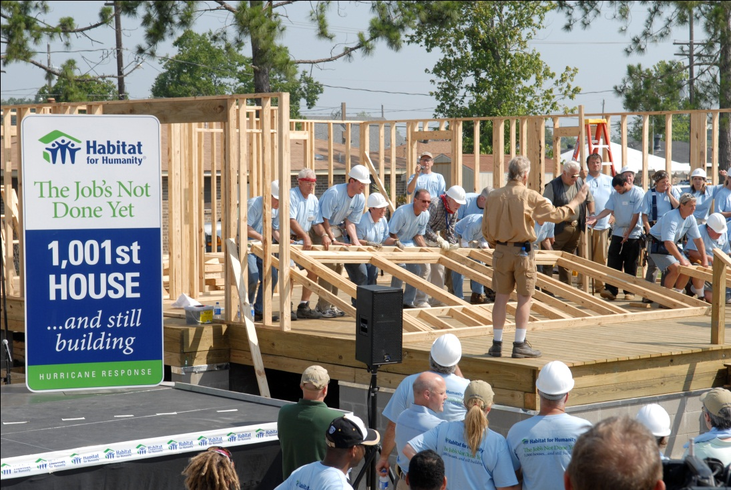
Hurricanes Katrina and Rita, 2005
Gulf Coast, USA
Over $120 billion worth of combined damages
550,000 homes damaged
2,219 Habitat homes have been built or repaired since 2005

Slide 9
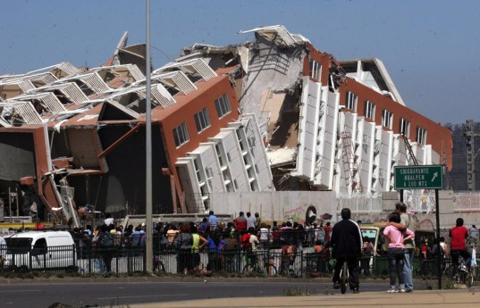
Chile Earthquake, 2010
500,000 homes sustained considerable damage
Construction of 1,000 new earthquake resistant core homes
Repair of 4,000 damaged homes

Slide 10
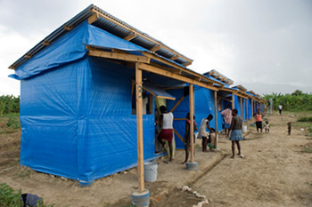
Haiti Earthquake, 2010
1.5 million people left displaced or homeless
550,000 still homeless after 2 years
Over 4,000 Haitians have received transitional or upgradable shelters
24,500 shelter kits distributed
12,500 housing damage assessments
500 homes built and repaired

Slide 11
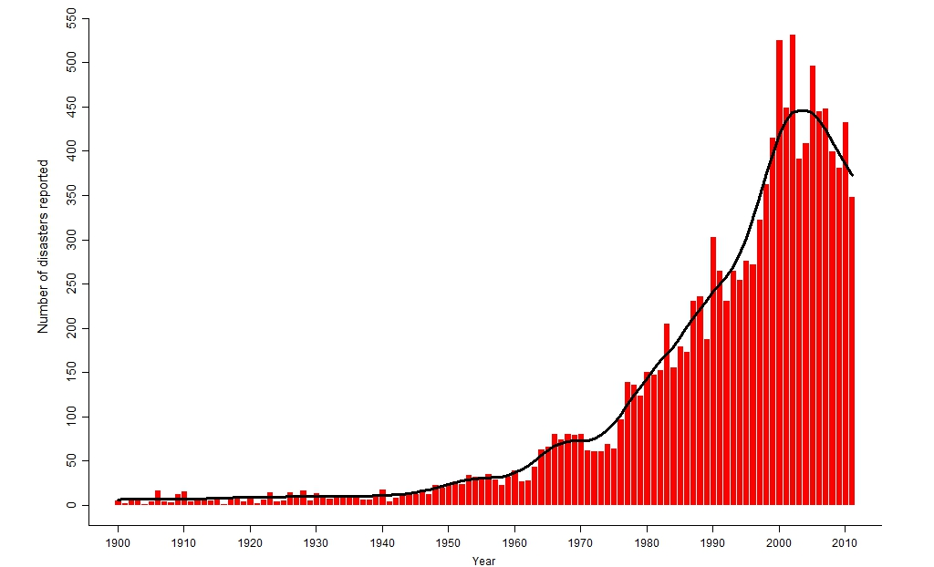
Number of disasters reported 1900-2011

Slide 12
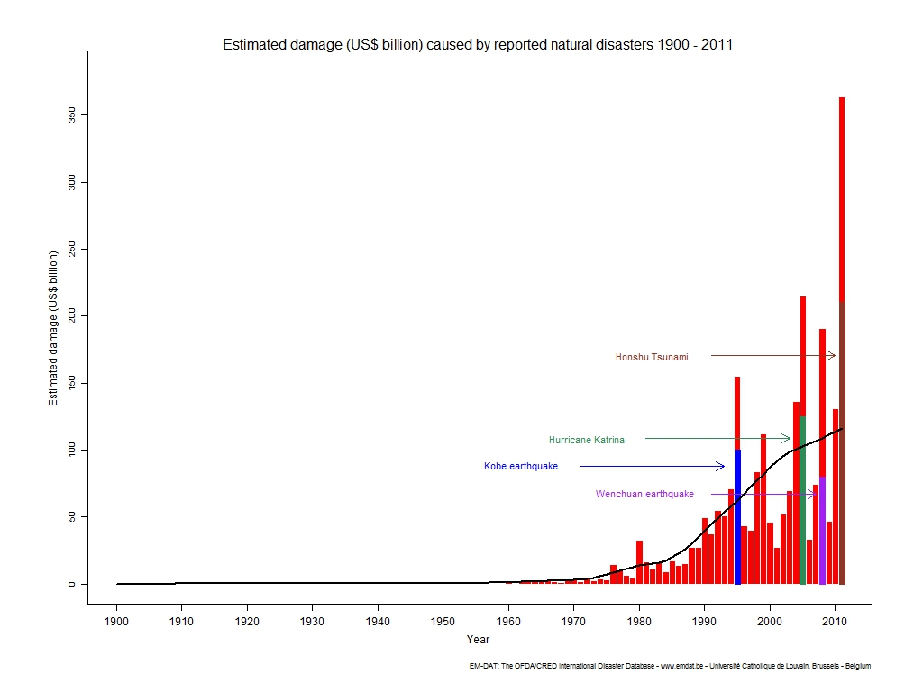
Estimated damages USD 1900-2011

Slide 13
“Natural disasters in all forms have been the greatest threat to our national security and public well-being. They have caused more damage to property and to citizens lives than any other factors. Disaster risk reduction is our top national priority”
President Yudhoyono of Indonesia, Keynote address 5th Asian Ministerial conference on DRR, 28th Oct 2012

Slide 14
Pathways to Permanence
Preparedness and Disaster Risk Reduction
Permanent, long term durable housing reconstruction
Multiple impact interventions
Community partnerships
Coordination

Slide 15
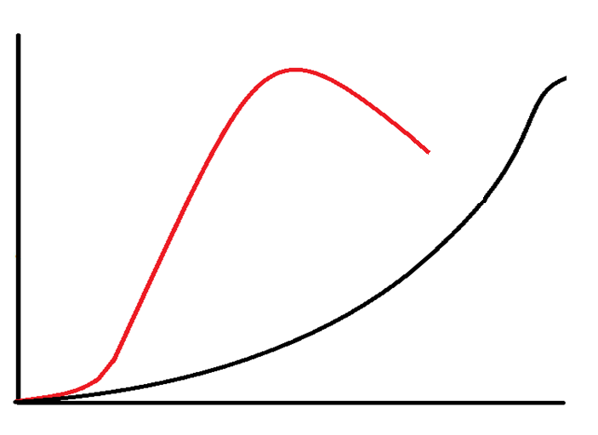
Disaster response profiles
Relief Agencies
Money
HFH
Time

Slide 16
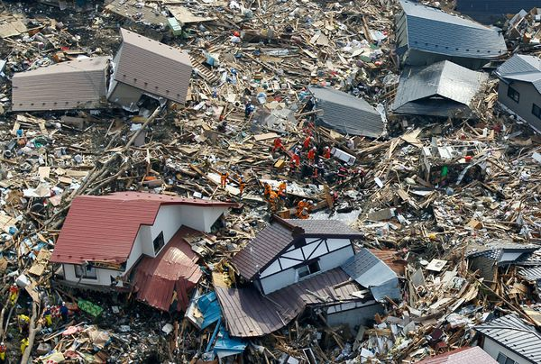
Japan Earthquake, 2011
Damage:
$239 billion worth of damages – ‘most expensive natural disaster in world history’
15,800 people killed
4.4 million households left
without electricity
1.5 million households left
without water

Slide 17
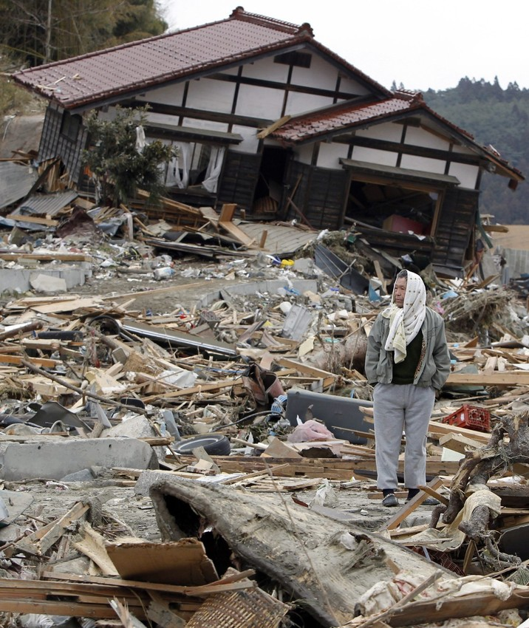
130,000 buildings totally collapsed
254,000 buildings ‘half collapsed’
691,000 partially collapsed
Response:
Working in Iwate and Miyagi Prefectures
Habitat volunteers have spent equivalent of
10,000 days clearing debris
1,000 volunteers travelled to communities in northern japan
15,000 people supported

Slide 18
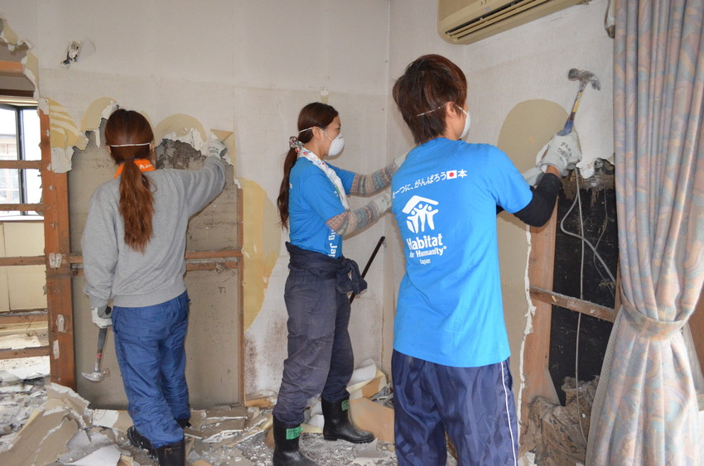
Re-build consultations provided for 1,000 families
Distribution of household and winter items to 3,900 families
400 homes cleared
Repaired 160 houses
Raised over $4.5 million for
disaster response

Slide 19
Video link:
‘Hammers of Hope: Helping Northern Japan Rebuild’

Slide 20
“People affected by disaster are
not victims; they are the first responders during an emergency and the most critical partners in reconstruction.”
World Bank 2010

