Slide 1




Reconstruction following a disaster

Slide 2
JAPAN
2011

Slide 3
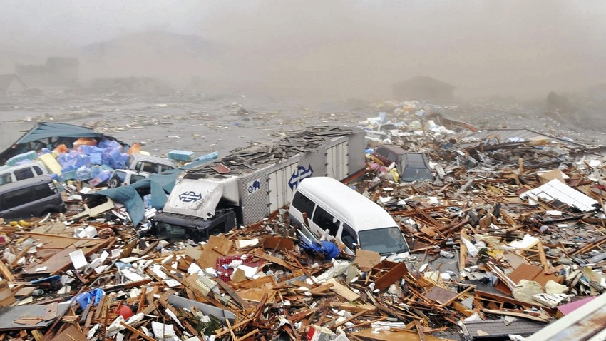
24,700 people affected
15,800 deaths
6,100 injured
2,800 missing

Slide 4
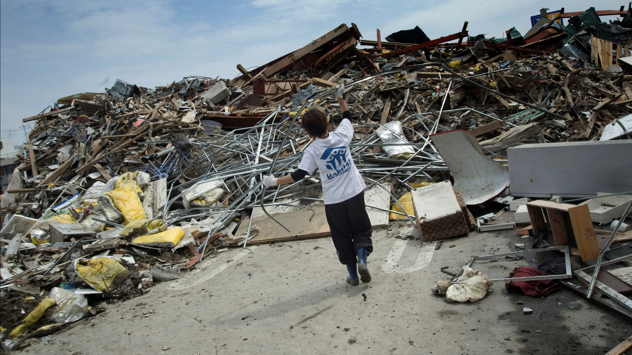

Slide 5
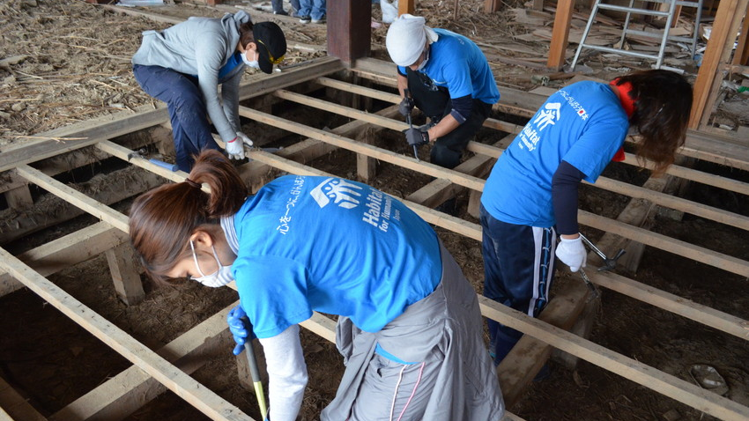
9,895
total volunteer days

Slide 6
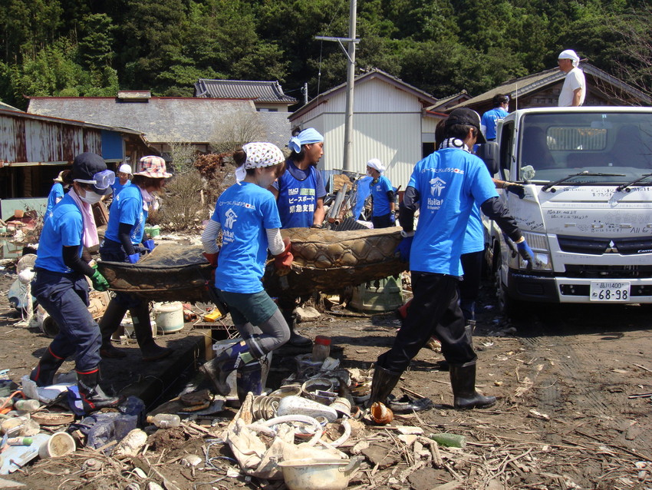

Slide 7


Slide 8
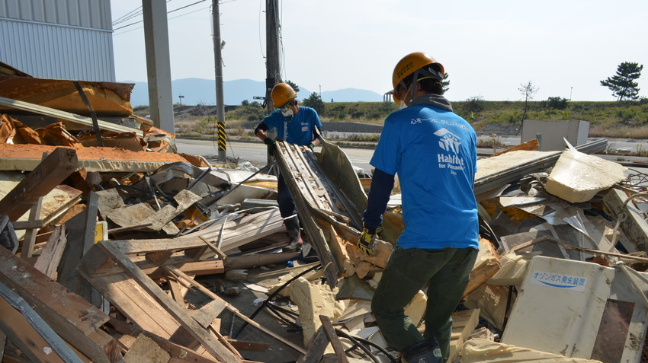
50,000 hours of volunteer clearing

Slide 9
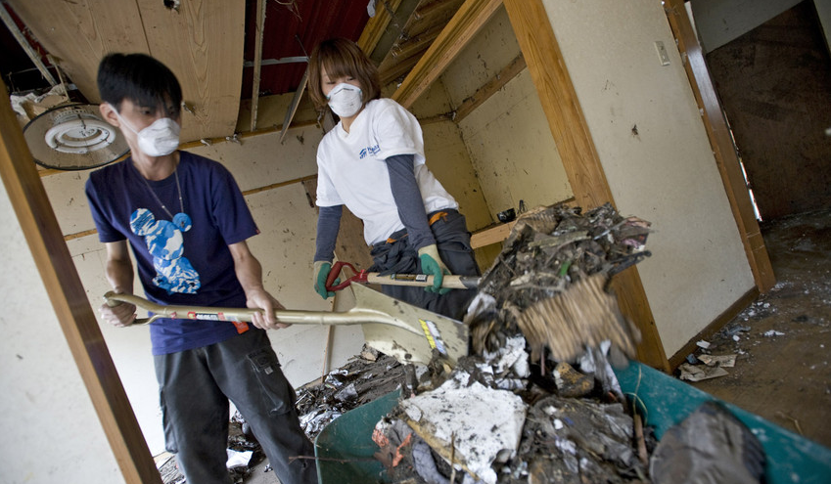

Slide 10
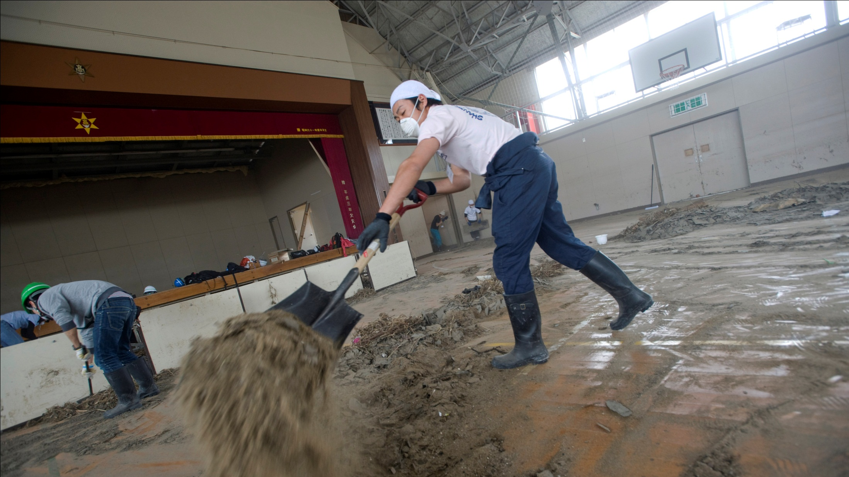

Slide 11
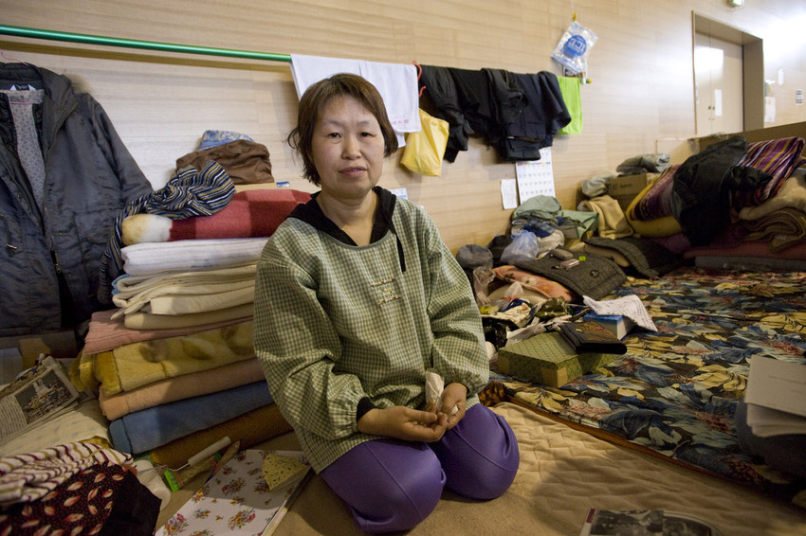
52,513
temporary
shelters erected

Slide 12
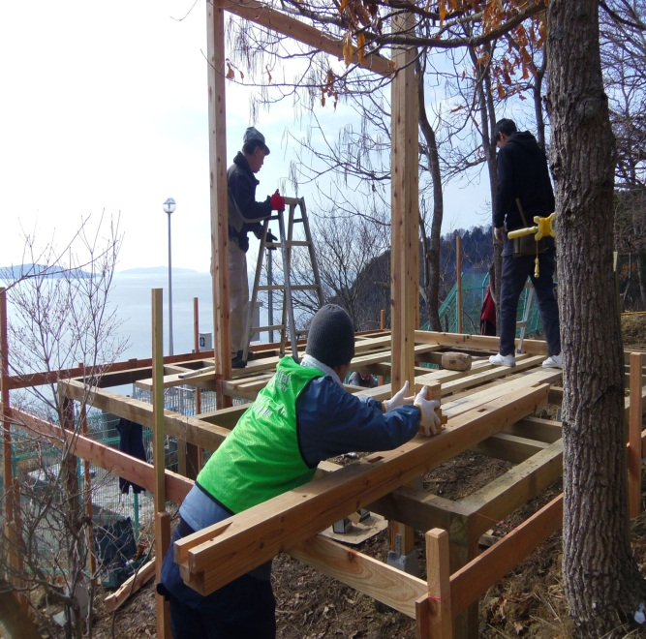

Slide 13

15,000 supported to
rebuild their lives

Slide 14


Slide 15
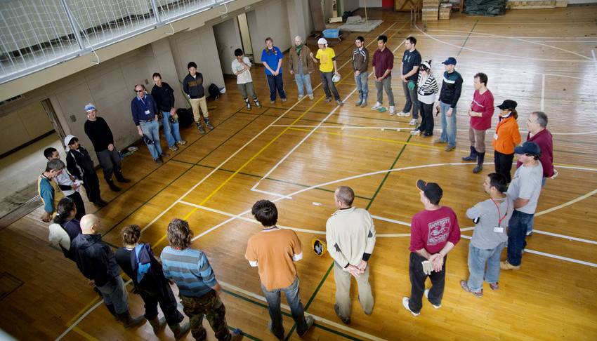
More than $4.5 million
raised by Habitat for Humanity's disaster response operation in Japan

Slide 16
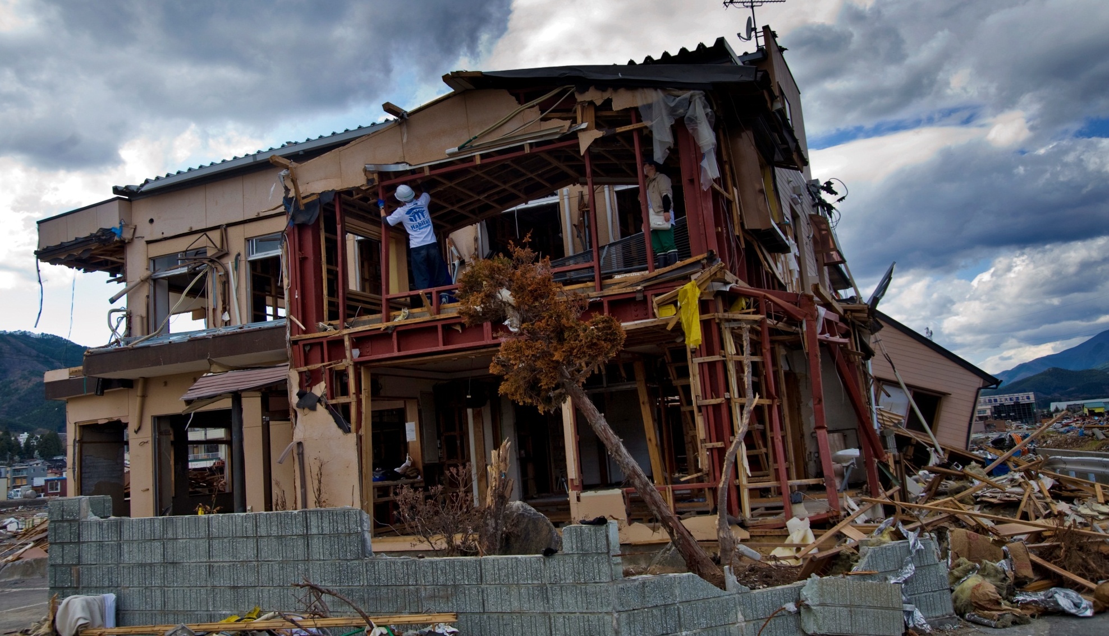
“The tsunami completely destroyed my house and damaged my business. I thought my life was over. However, the action of volunteers have reminded me to stand up, live, and face another day.”
Business owner, Hideo Takahashi.

Slide 17
US GULF COAST
Hurricanes
Katrina & Rita
2005

Slide 18
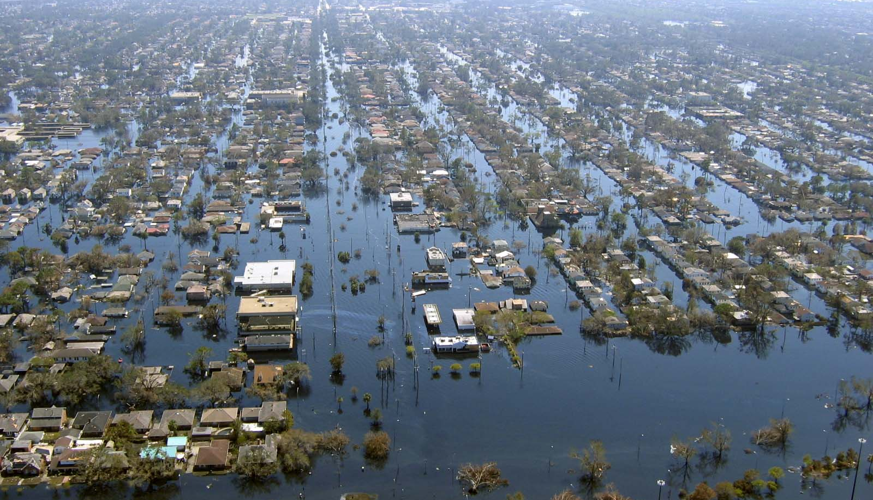
90,000 square miles declared ‘disaster area’ (nearly size of the whole United Kingdom)

Slide 19
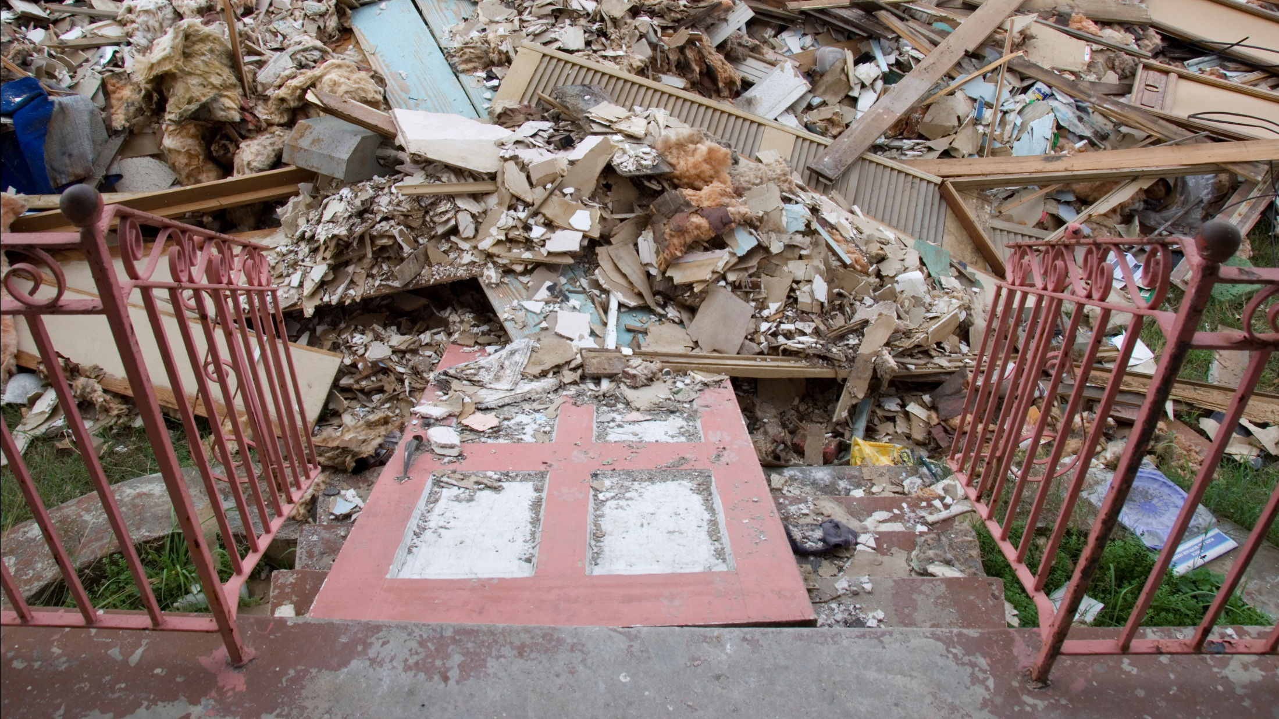

Slide 20
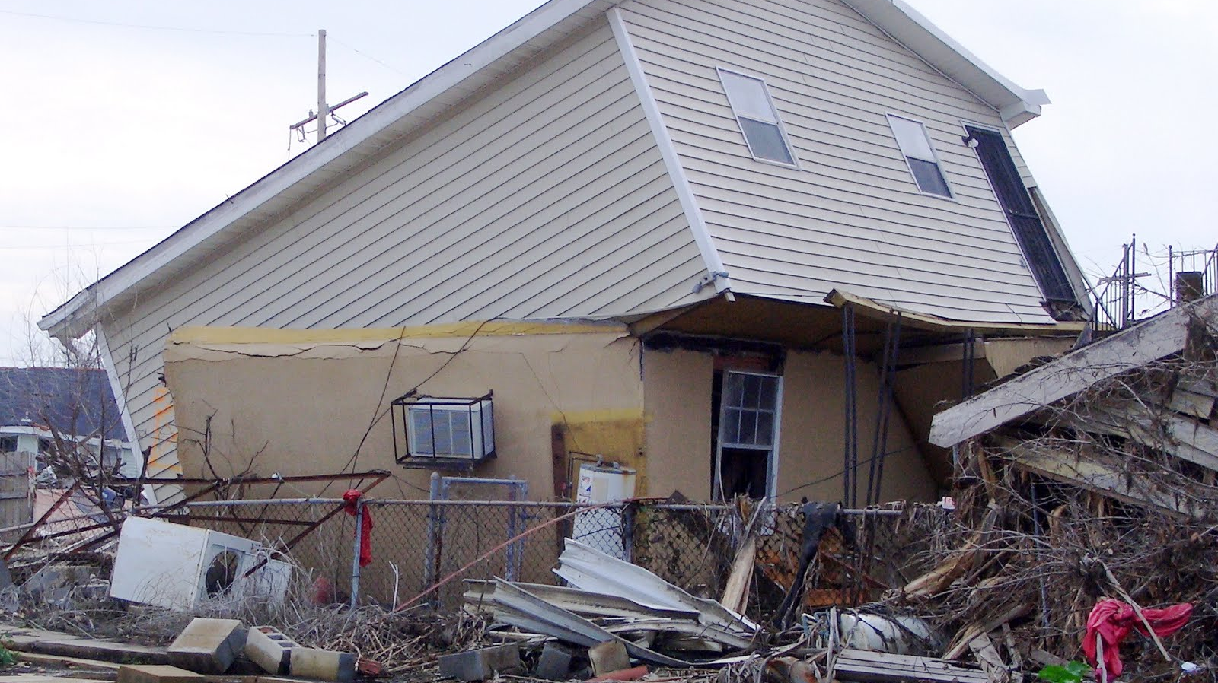
$150 billion
estimated
total damage
from hurricanes
Rita and Katrina

Slide 21
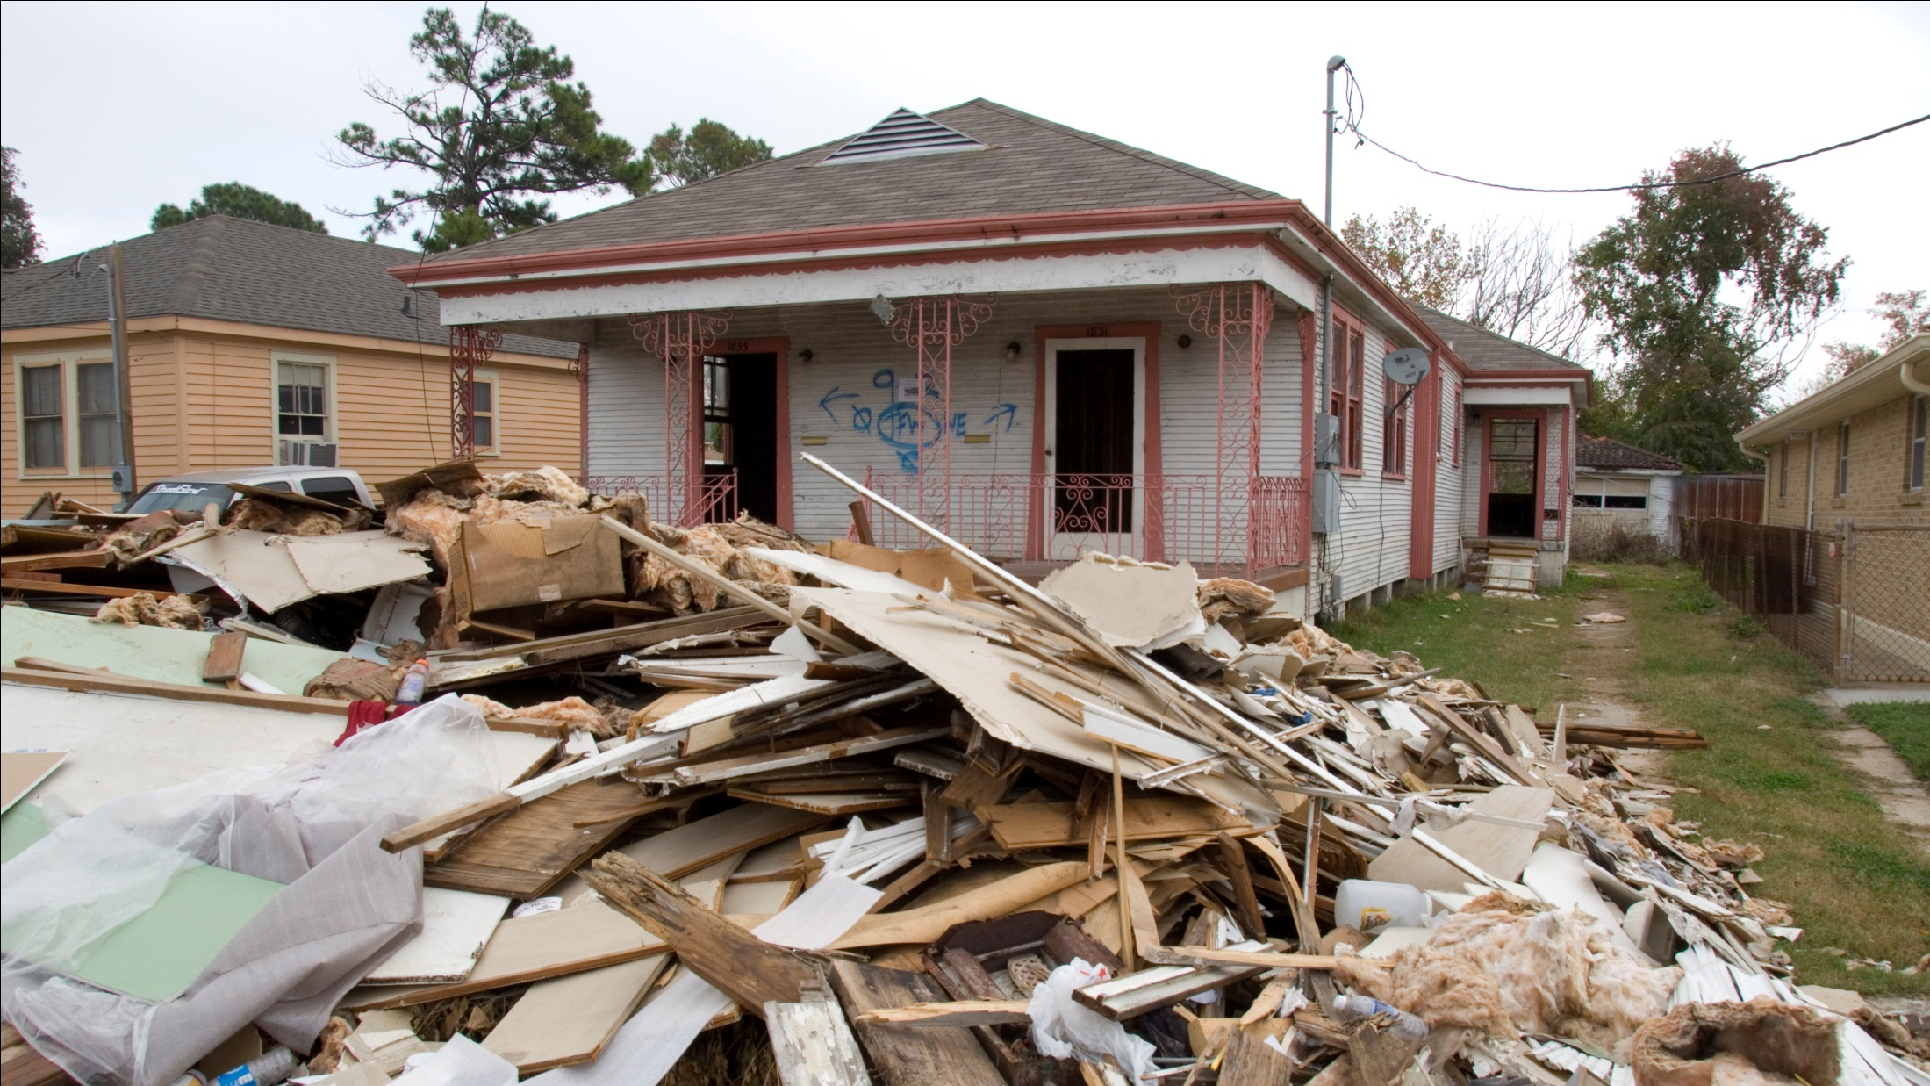

Slide 22
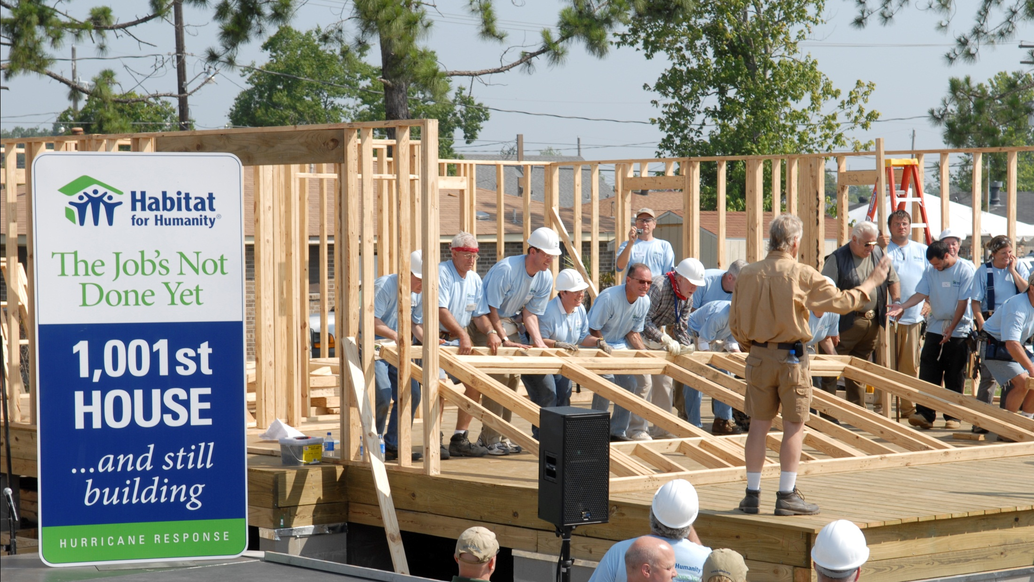

Slide 23
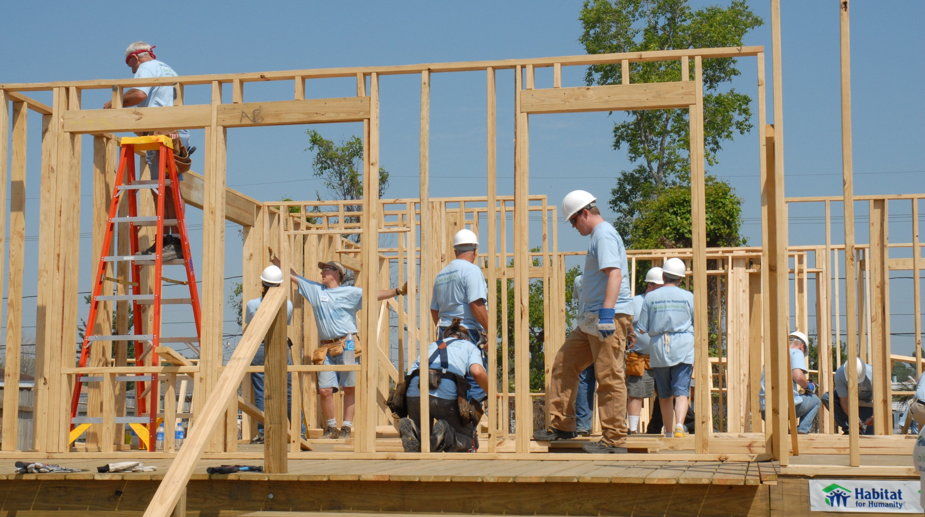

Slide 24


Slide 25


Slide 26
HAITI
2010

Slide 27
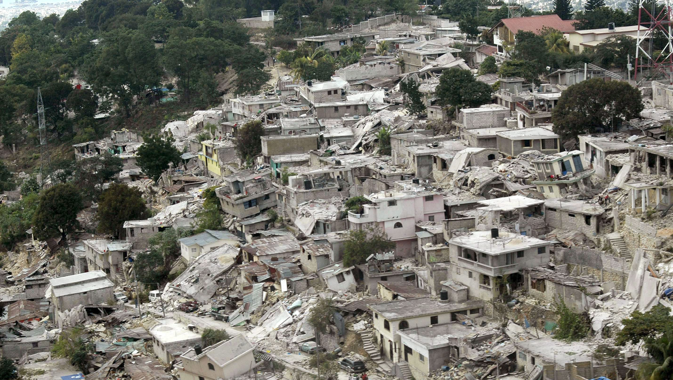
105,000 houses completely destroyed

Slide 28
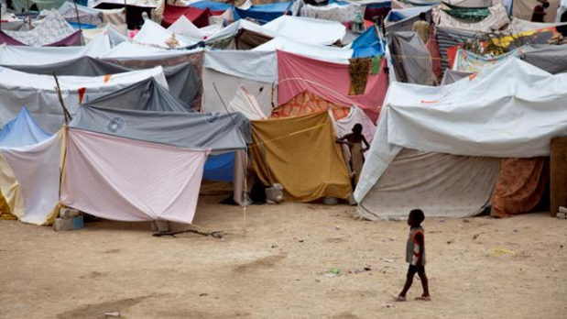

Slide 29
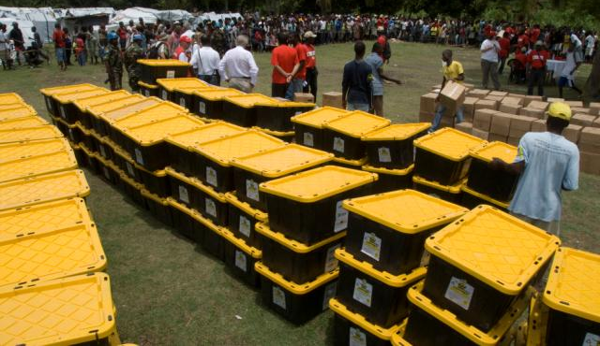
21,000 Haitian families provided with emergency shelter kits

Slide 30
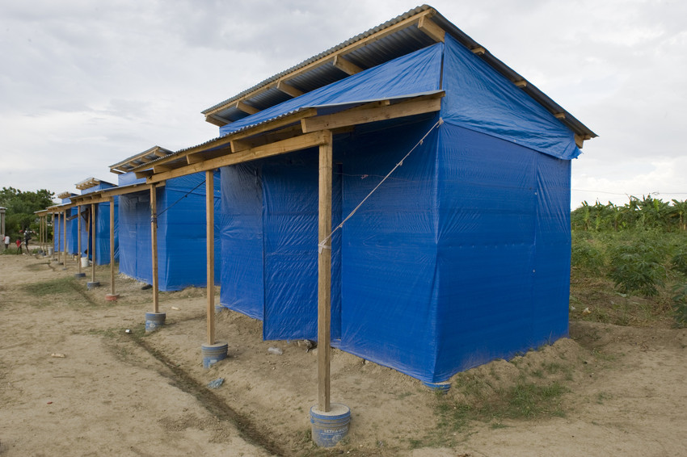
More than 4,000
families received transitional or upgradable shelters

Slide 31


Slide 32
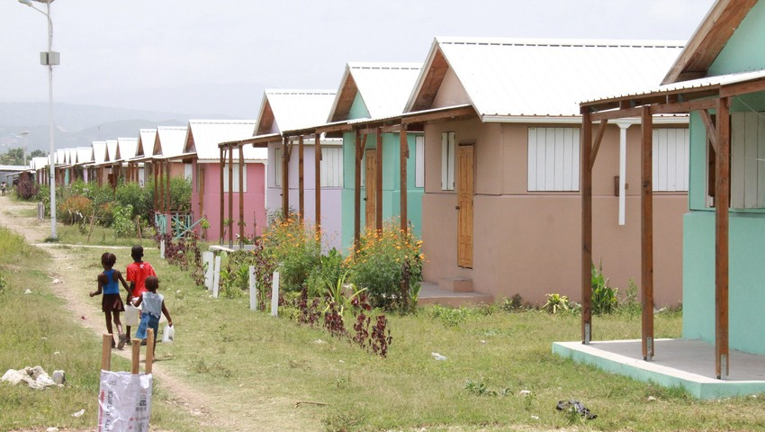

Slide 33
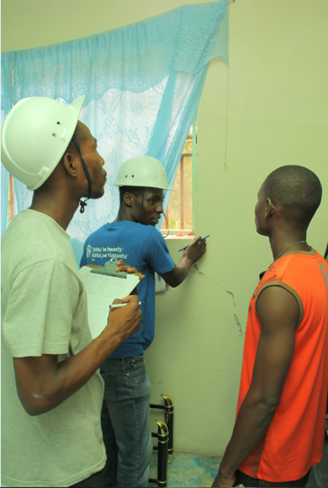
Over 4450
Haitians trained in construction techniques, damage assessments, disaster risk reduction and damage assessments

Slide 34
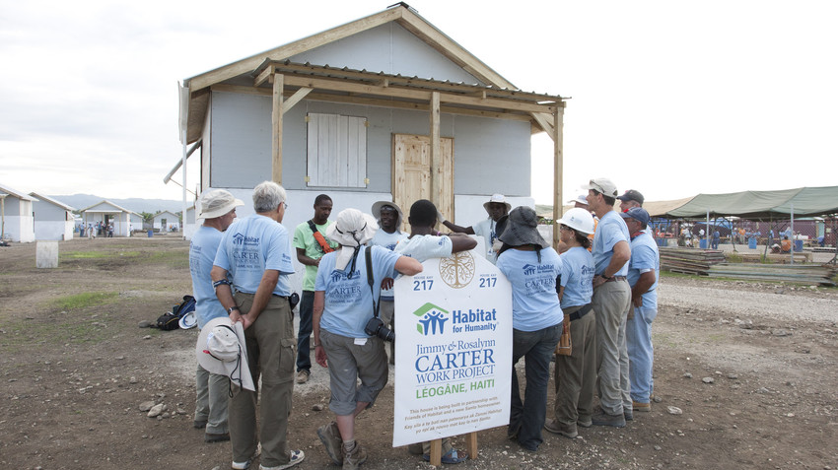

Slide 35
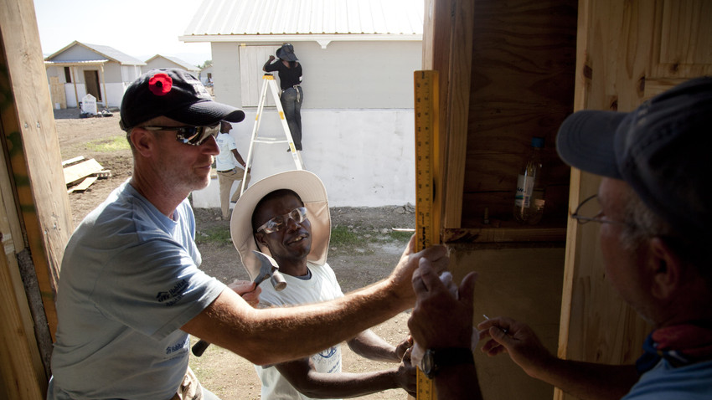
“People affected
by disaster are
not victims; they
are the first responders during
an emergency
and the most
critical partners
in reconstruction.”
World Bank 2010

Slide 36
Philippines
Storm Washi
2011

Slide 37
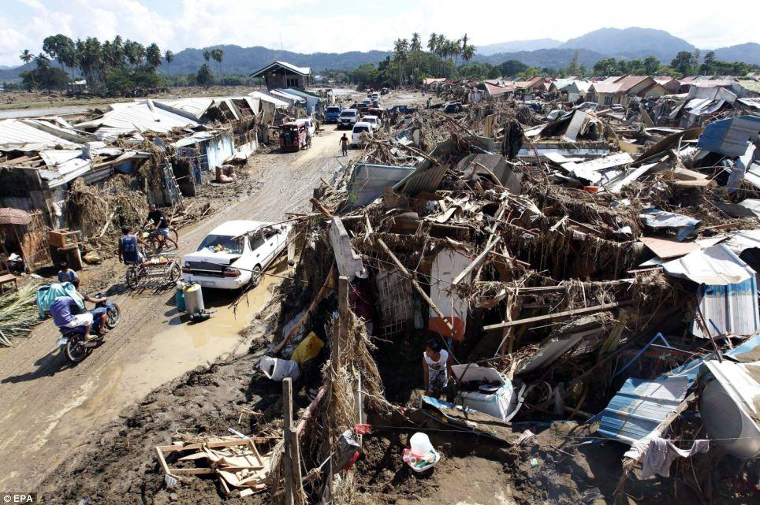
52,435
houses damaged or affected

Slide 38
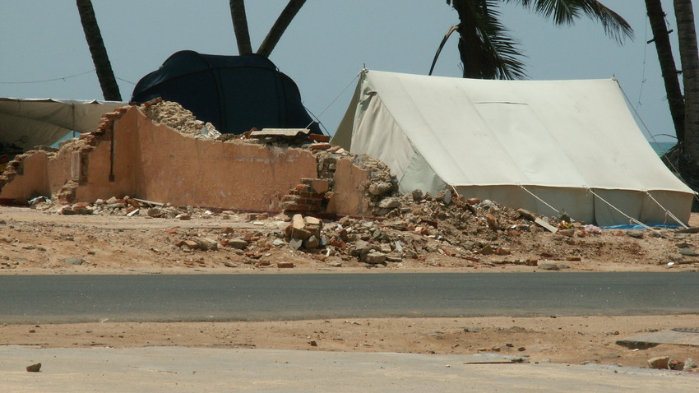

Slide 39
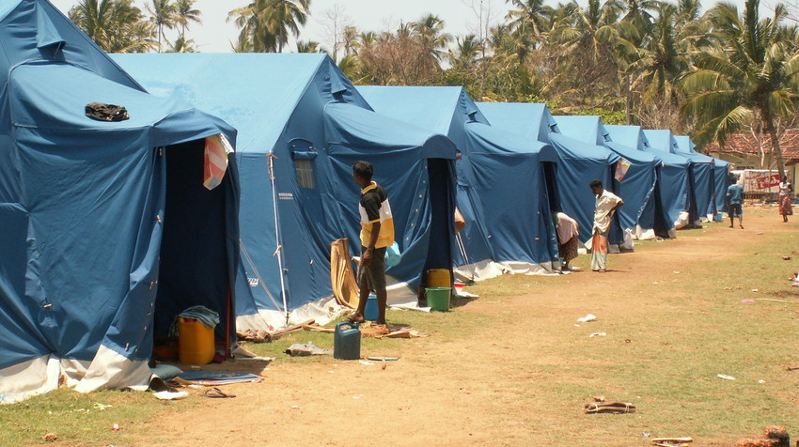
5,000
displaced families assisted

Slide 40
Thailand
2011

Slide 41
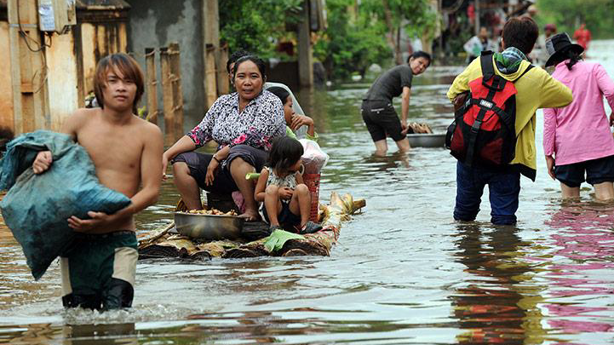
Over 3 million people affected

Slide 42
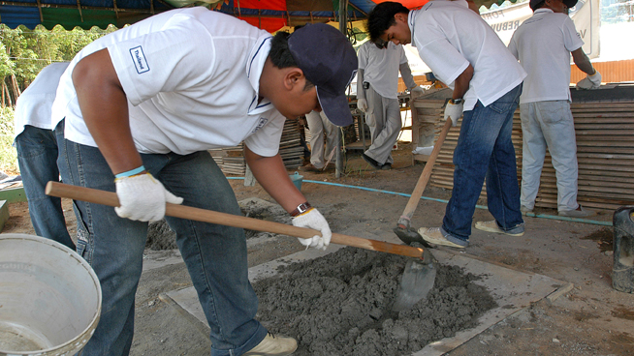

Slide 43
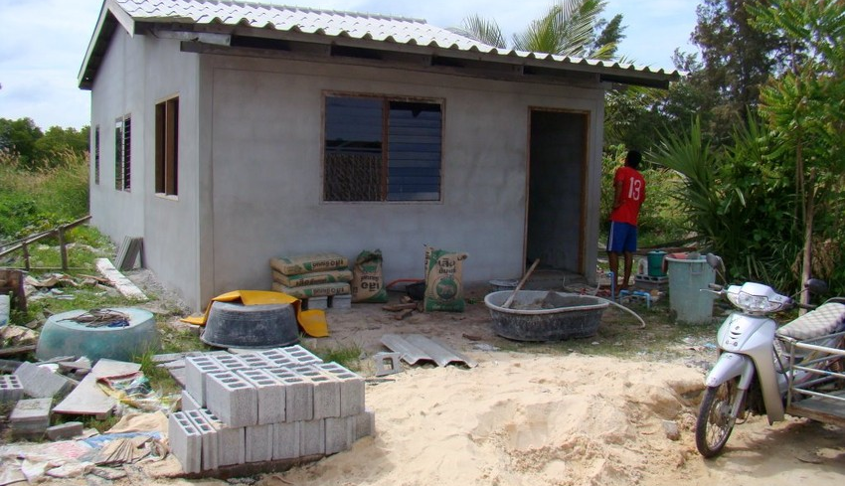

Slide 44
Sri Lanka
2011

Slide 45
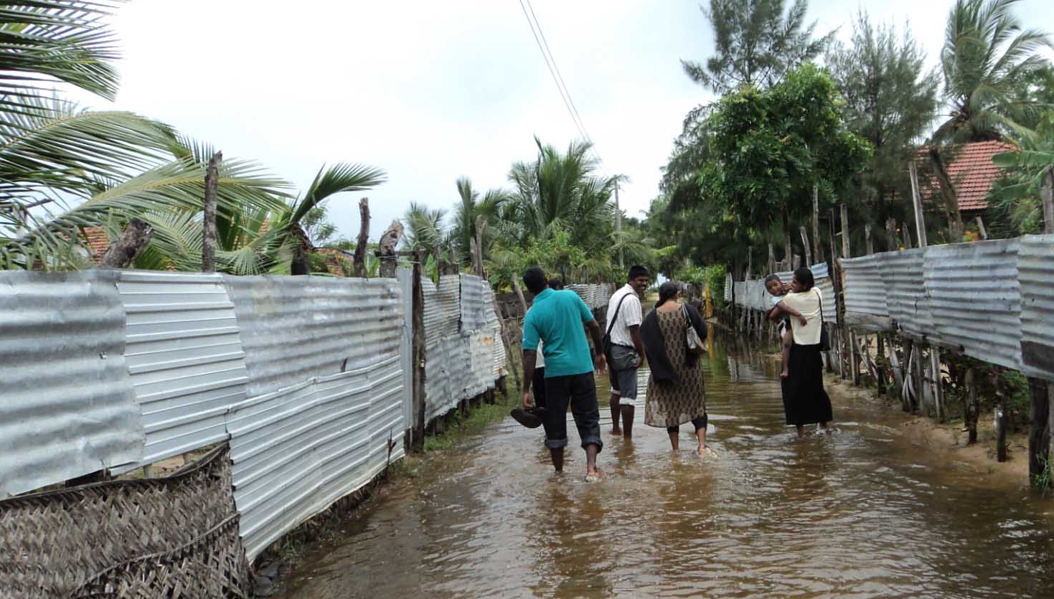
$450m
estimated economic losses

Slide 46
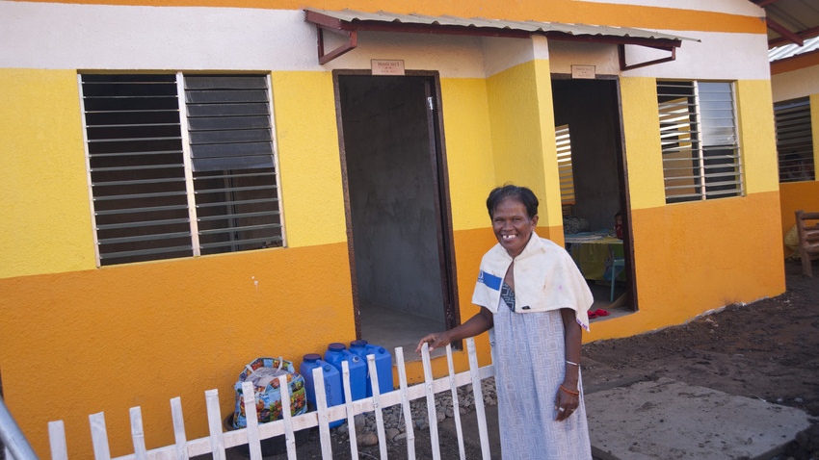
1,960
families
assisted

Slide 47
“When you look at the recent disasters, the destruction of shelter has been a major theme. Shelter has a catalytic impact in helping people and communications recover from shocks and improve long term prospects, and it is imperative the shelter reconstruction is not forgotten when formulating a humanitarian response”
Ian Walkden, National Director, Habitat for Humanity Great Britain

